Slide 1

EMPLOYEE DATA MANAGEMENT SYSTEM

Slide 2

INTRODUCTION
Full Stack Application – EMPLOYEE DATA MANAGEMENT SYSTEM
Employee Database Management System is a software that allows employee to register itself and allows only admin to access the data and perform various operation on data according to the requirement .
Employee database management software is a self-service system that allows employees to enter, update and access their data.

Slide 3
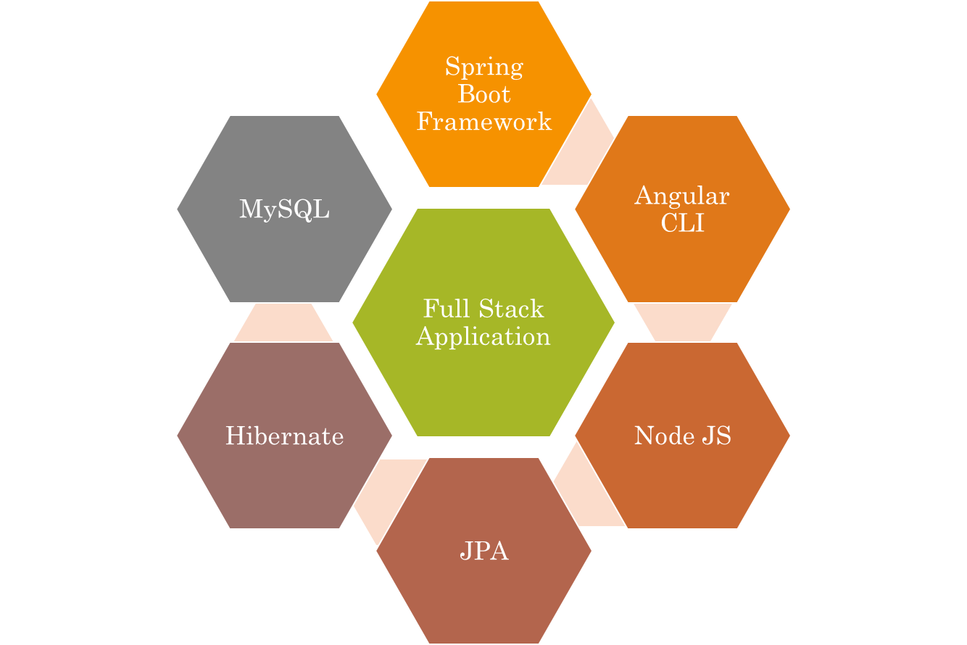
Technologies used.

Slide 4
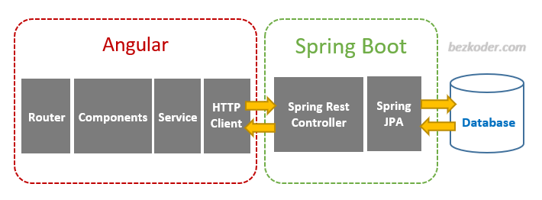


The Architecture of Angular, Spring
& database(MySQL)

Slide 5
The Architecture of the Project
Angular JS
Node JS
Frontend
Spring Boot
Backend
MySQL

Slide 6
CRUD Operations
View Record
Update Record
Delete id
CRUD
Add id

Slide 7
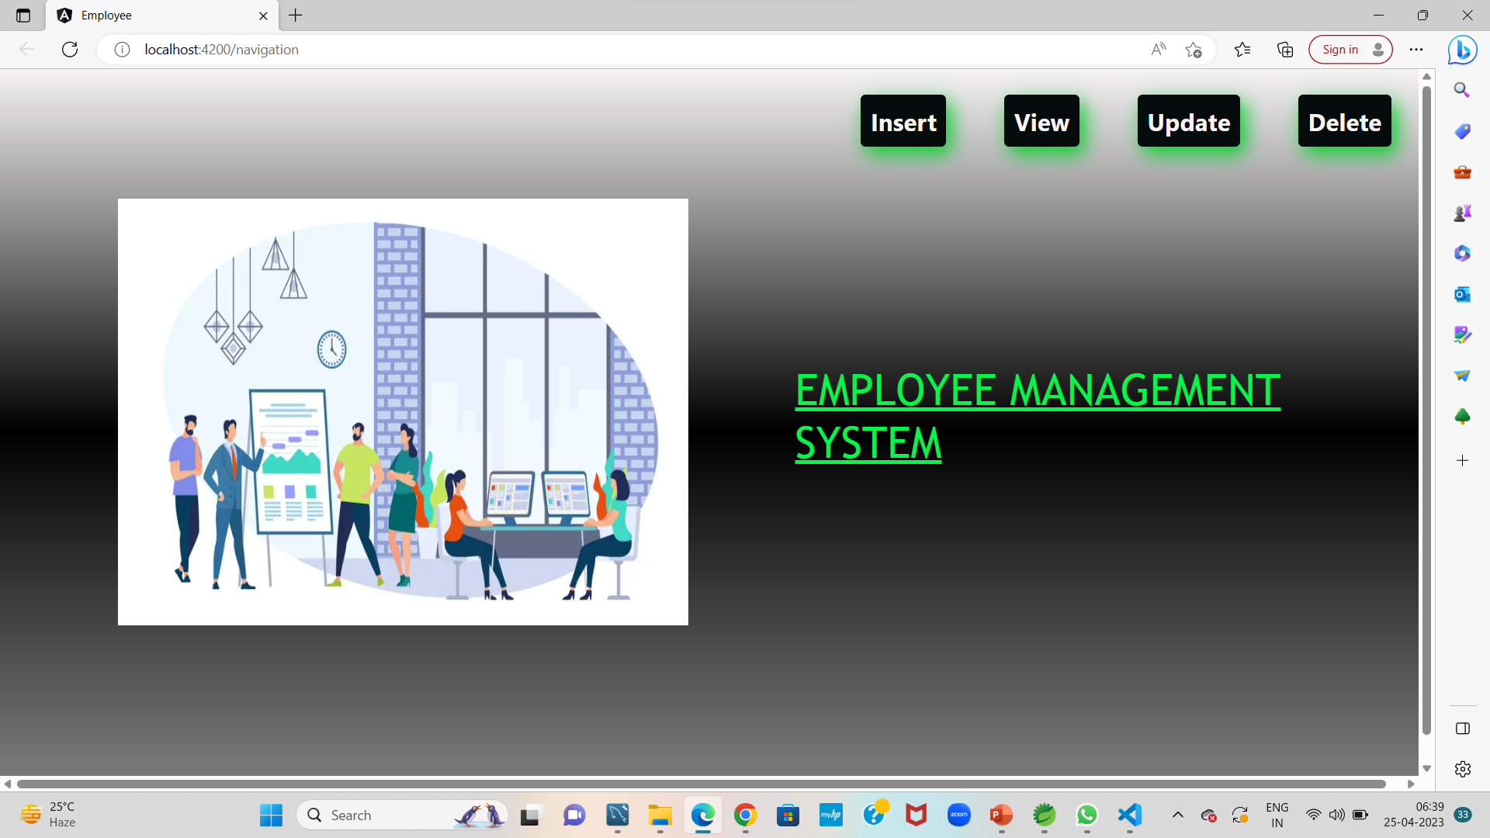
Home Page

Slide 8
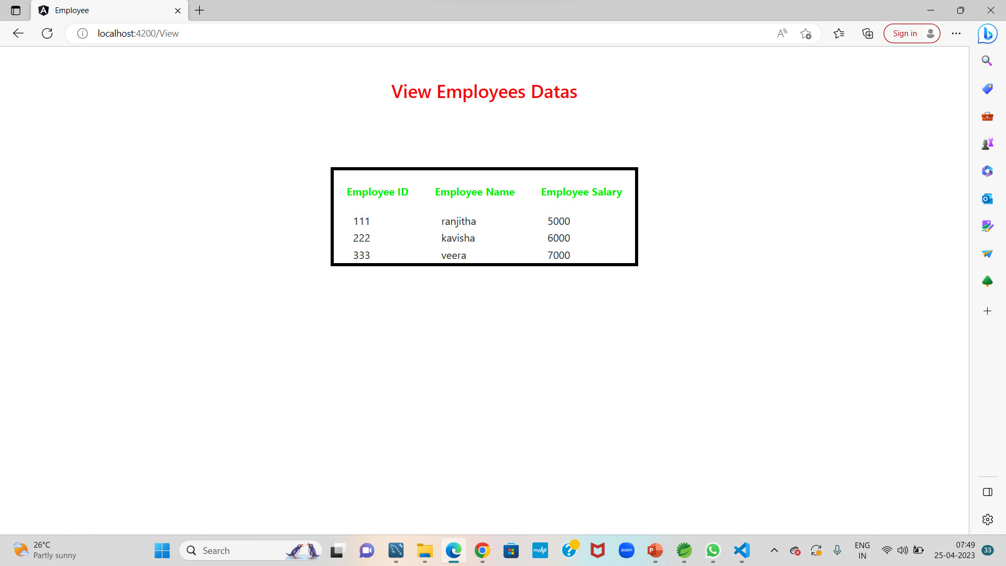
Service Page

Slide 9
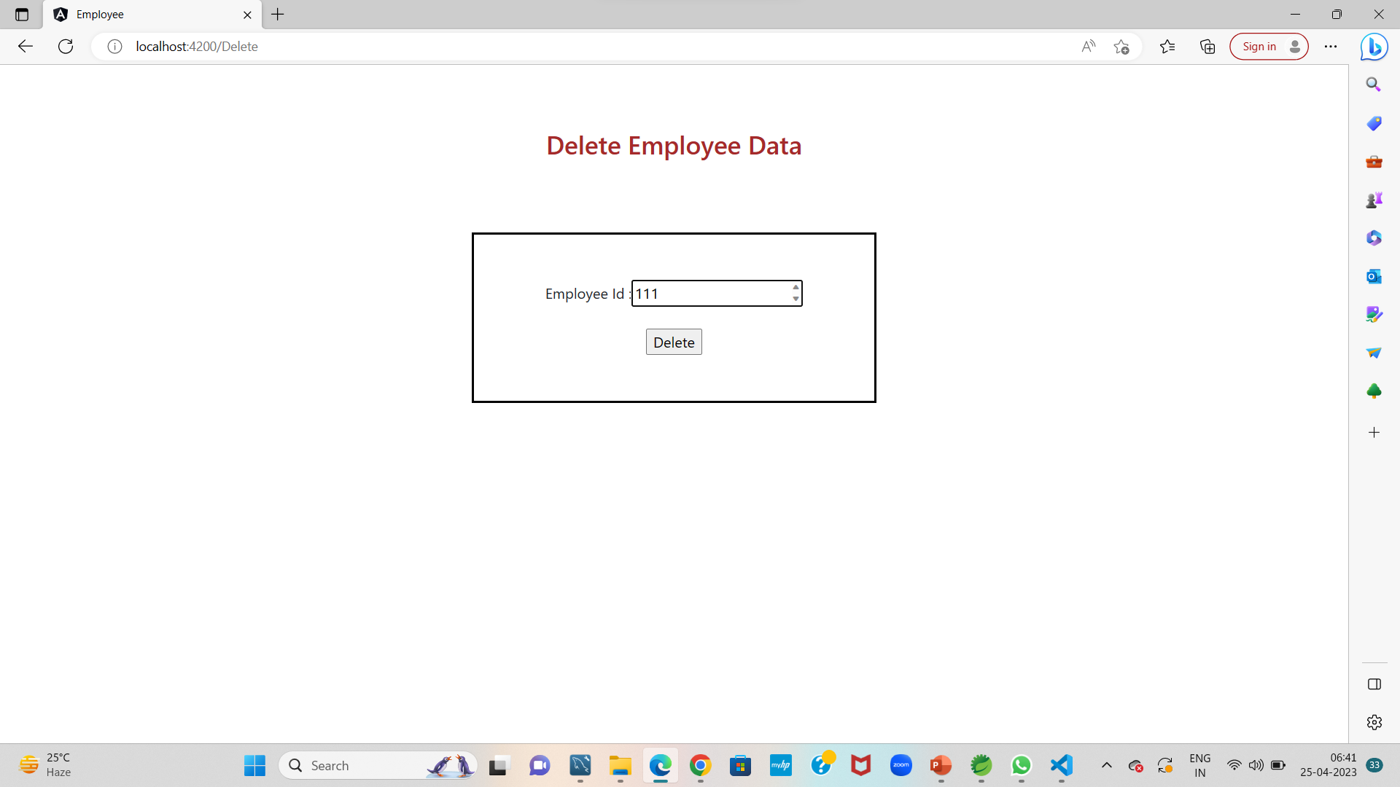
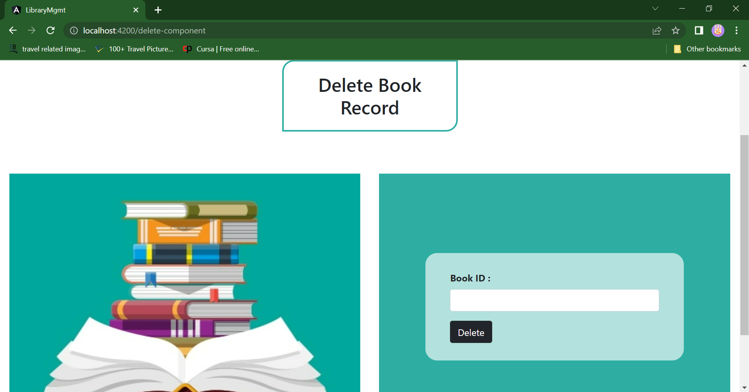
ADD & Delete Page.

Slide 10
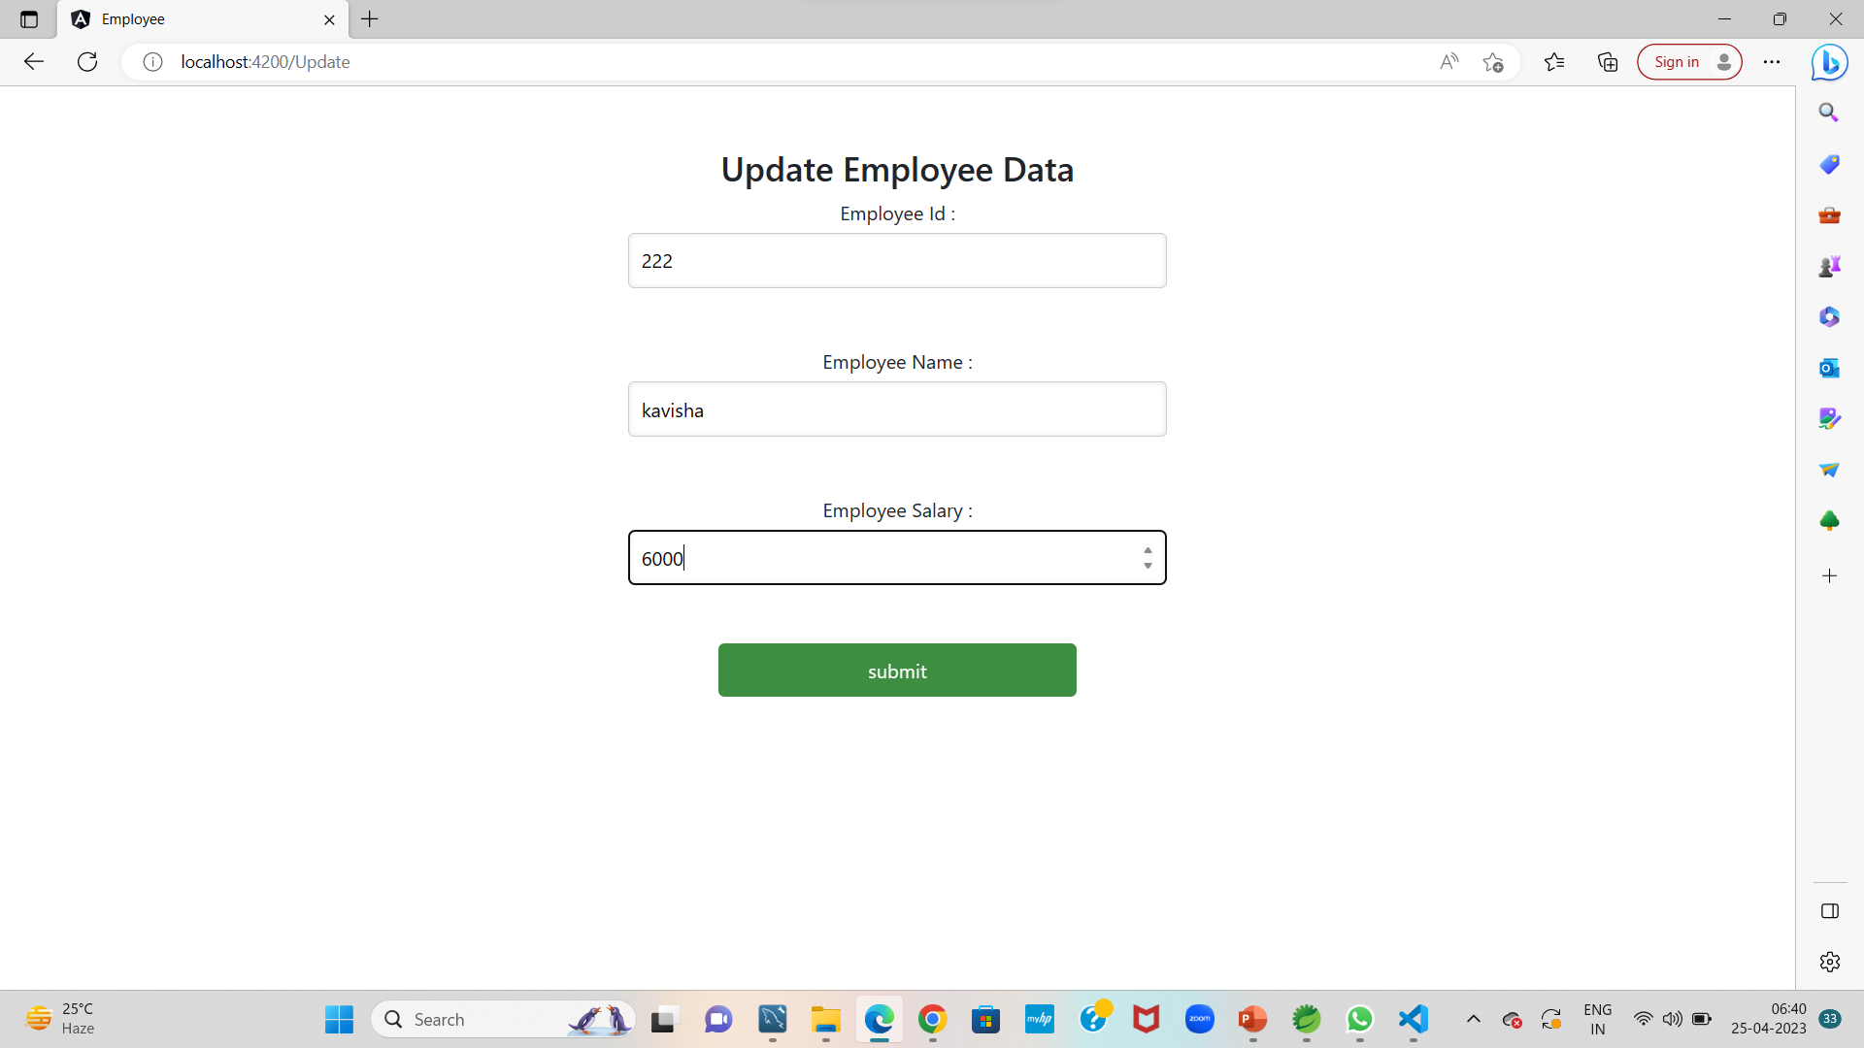
Update Page

Slide 11
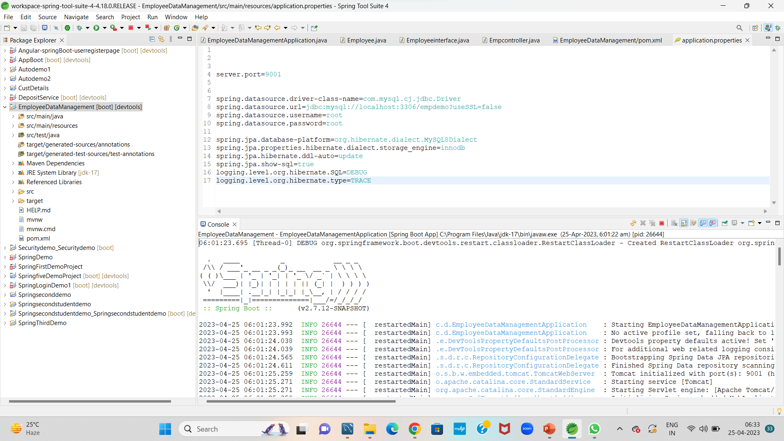
Spring Boot Application

Slide 12
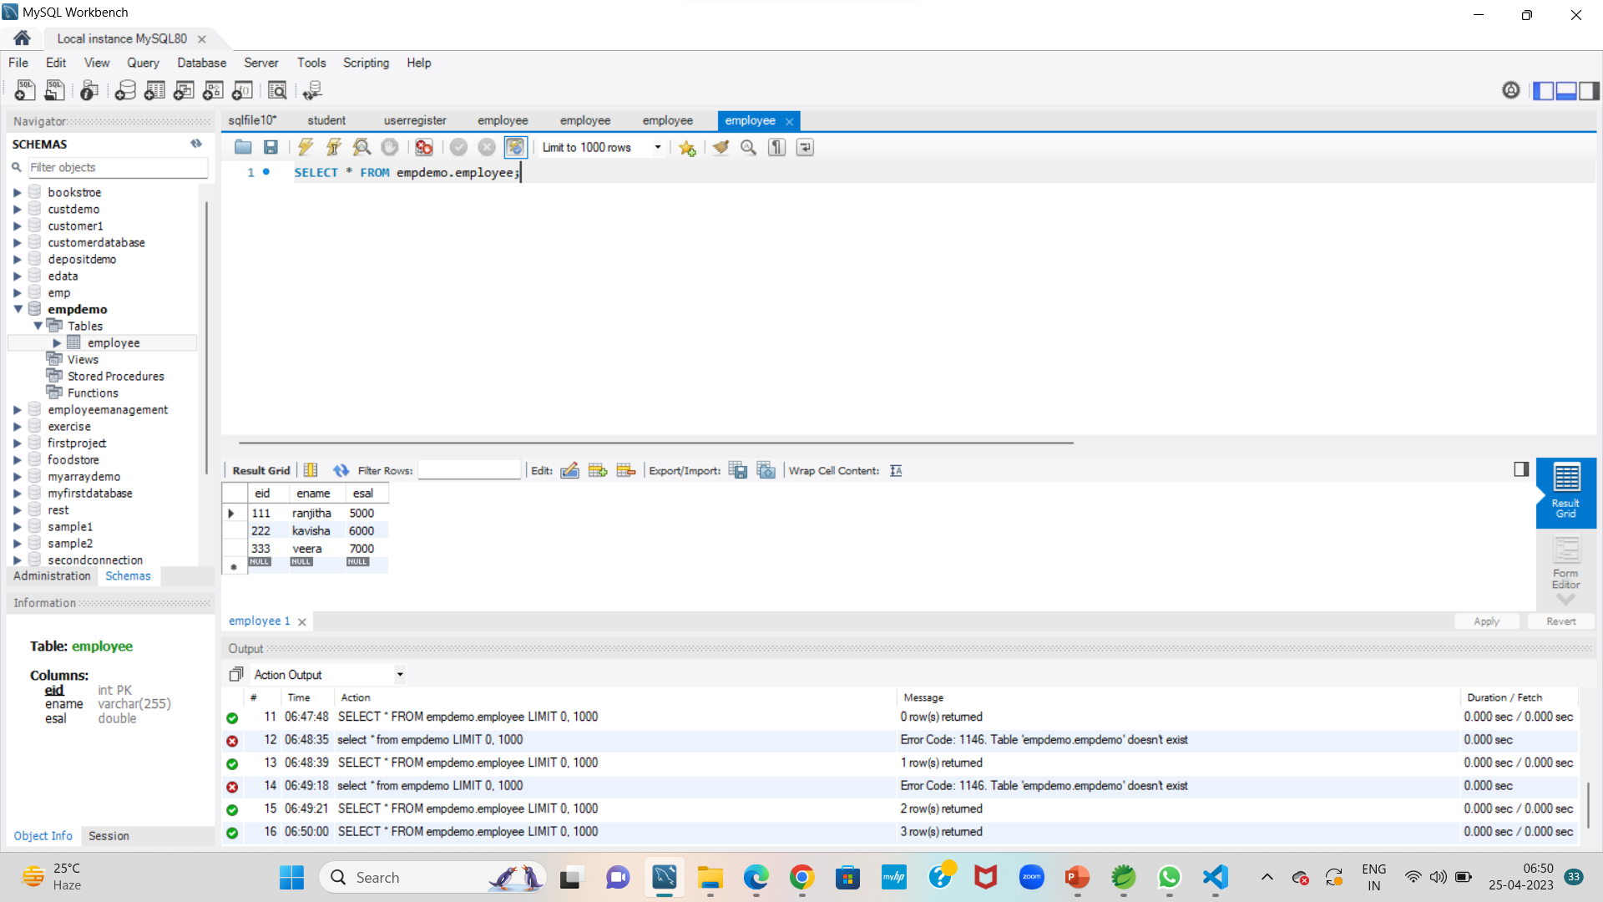
MySQL Code

Slide 13
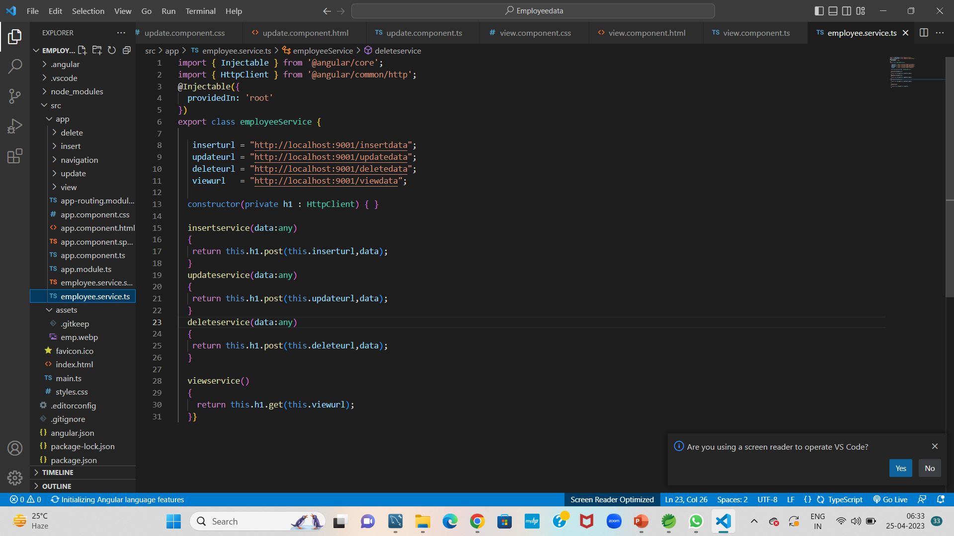
Frontend – Angular JS

Slide 14

The scope of this project is as follows:
Enhanced learning experience : By using a employee management system with CRUD operations .
Compaines can provide employees with a better learning experience for example employee can access their admin and resource online and receive feedback and grades in real time
The system generates types of information that can be used for various purposes.

Slide 15

Thank you.

